Slide 1
A Deep Learning System For Detecting Diabetic Retinopathy Across The Disease Spectrum
Presented by - Salman Ibne Eunus
Course Code - CSE713 - Pattern Recognition
ID - 22266008

Slide 2
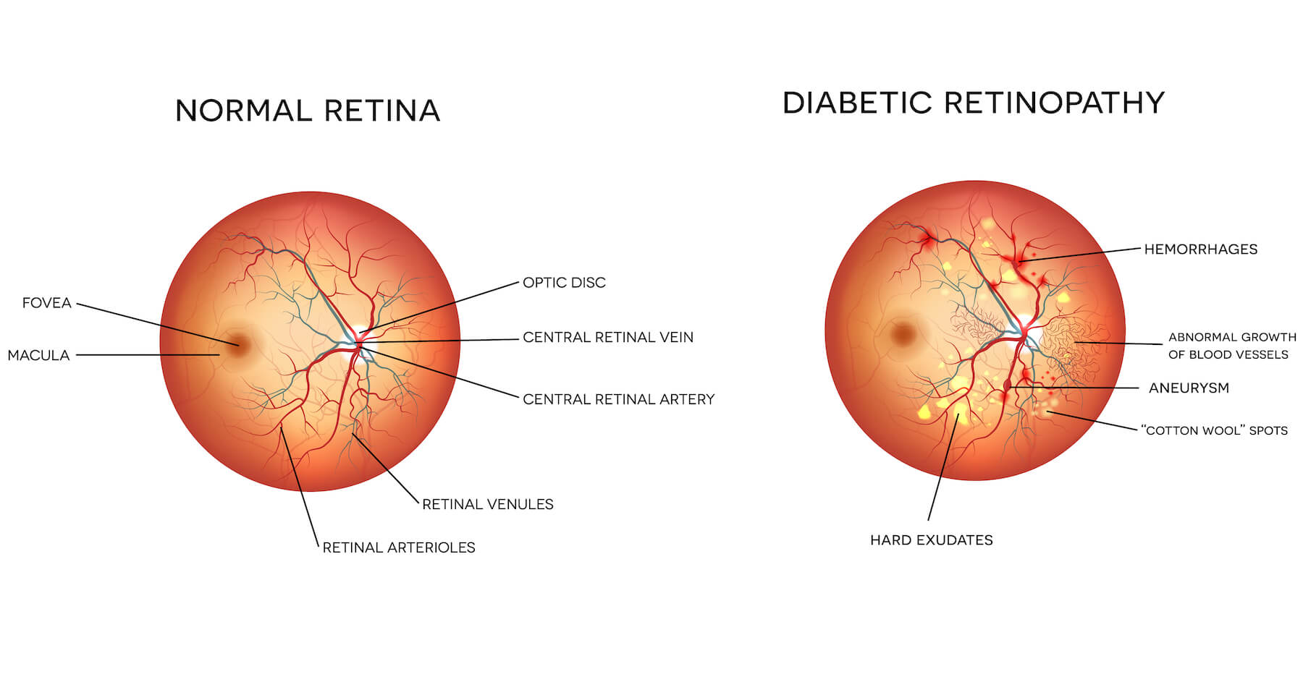
Introduction
Approximately 600 million people will have diabetes by 2040, with one-third expected to have Diabetic Retinopathy (DR).
Diabetic Retinopathy is the most prominent cause of vision loss in working age adults worldwide.
Regular DR screening is recommended as it will ensure early detection and treatment at the correct time and thus vision loss can be prevented.
Comprehensive DR screening is not carried out widely due to lack of human assessors and also lack of training.
As a result, diagnostic system using deep learning algorithms is required to facilitate DR screening.

Slide 3
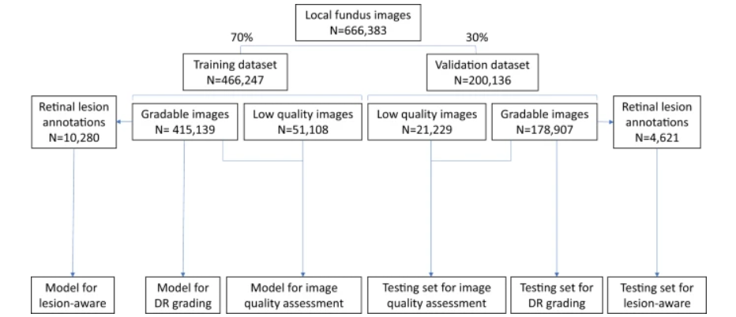
Dataset Collection & Description
Retinal photographs were captured using desktop retinal cameras and the operators were all trained and followed standard procedures.
The images were further verified using 33 certified ophthalmologists. For each type of lesion, 2 ophthalmologists produced 2 lesion annotations.
Local dataset was randomly divided into training or validation sets. All 466,247 images in the training dataset were used for training the image quality assessment sub-network.
DR severity was graded into 5 levels which includes - non-DR, mild non-proliferative DR (NPDR), moderate NPDR, severe NPDR or PDR.

Slide 4
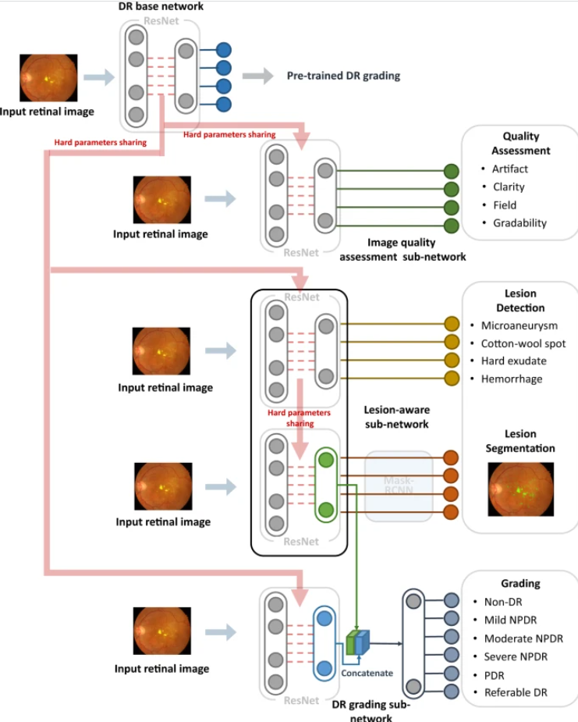
Architecture of the Model
A deep learning based DR screening system called DeepDR (Deep-learning Diabetic Retinopathy) has been developed.
The DeepDR system consisted of three deep-learning sub-networks: image quality assessment sub-network, lesion-aware sub-network, and DR grading sub-network.
These sub-networks were developed based on ResNet and MaskRCNN. It is a transfer learning based multi-task network to evaluate retinal image quality, retinal lesions and DR grades.
Both ResNet and Mask-RCNN could be divided into two parts: (1) feature extractor, which took images as input and output features, (2) task-specific header, which took the features as input and generated task-specific outputs (i.e., classification or segmentation)

Slide 5
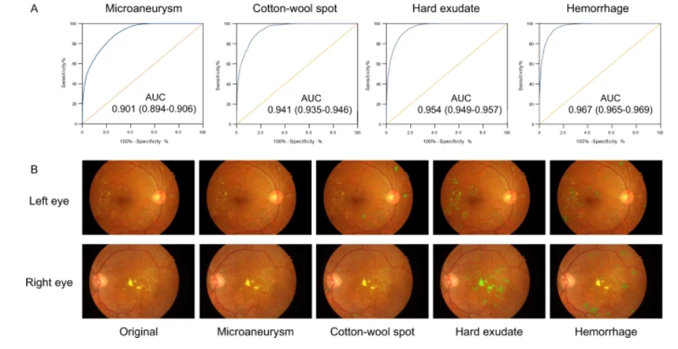
Results / Performance
DeepDR achieved an AUC of 0.934 (0.929–0.938) for overall image quality. For the identification of artifacts, clarity, and field definition issues, the system achieved AUCs of 0.938 (0.932–0.943), 0.920 (0.914–0.926), and 0.968 (0.962–0.973), respectively.
For microaneurysm, the AUC, sensitivity, specificity, and F-score were 0.901 (0.894–0.906), 88.0% (87.2–88.9%), 73.3% (72.0–74.3%), and 0.815, respectively.
For CWS, the AUC, sensitivity, specificity, and IoU were 0.941 (0.935-0.946), 90.0% (87.9-91.9%), 83.1% (82.2–83.9%), and 0.711, respectively.
For hard exudate, the AUC, sensitivity, specificity, and IoU were 0.954 (0.949–0.957), 90.5% (88.9–91.5%), 85.8% (85.2–86.6%), and 0.971, respectively. For hemorrhage, the AUC, sensitivity, specificity, and IoU were 0.967 (0.965–0.969), 93.2% (92.6–94.1%), 88.0% (87.6–88.7%), and 0.738, respectively.

Slide 6
Conclusion
The DeepDR system achieved high sensitivity and specificity in DR grading. Rather than just generating a DR grading, it offers visual hints that help users to identify the presence and location of different lesion types.
Introducing the image quality sub-network and lesion-aware sub-network into DeepDR improved the diagnostic performance and more closely followed the thought process of ophthalmologists.
DeepDR can run on a standard personal computer with average-performance processors. Thus, it has great potential to improve the accessibility and efficiency of DR screening.

